Slide 1
CARVION AI
AI-Powered Career Development Platform

Slide 2
INTRODUCTION
Carvion AI is an AI-powered career development platform designed for students and job seekers. It helps users improve their career readiness by providing intelligent career guidance and personalized recommendations.
The platform combines multiple career services into a single application, including resume analysis, ATS score evaluation, career roadmaps, mock interviews, job and course recommendations, an AI chatbot, and an administrator dashboard.
Developed using React, Django REST Framework, MongoDB, Google Gemini AI, and JSearch API, Carvion AI provides a secure, user-friendly, and efficient environment to support career planning and professional growth.

Slide 3
PROBLEM STATEMENT
Students use multiple platforms for resumes, job search, learning, and interview preparation, making career planning difficult.
Traditional resume builders focus on formatting and do not provide ATS analysis, skill gap identification, or improvement suggestions.
Career guidance and interview coaching are often expensive and not easily accessible to every student.
A single AI-powered platform is needed to provide resume analysis, career guidance, interview preparation, job recommendations, and learning support in one place.

Slide 4
EXISTING SYSTEM
Separate platforms are used for resume creation, job search, learning, and interview preparation.
Resume builders (Canva, Zety, Novorésumé) create resumes but do not provide AI-based ATS analysis or skill gap identification.
Job portals (LinkedIn, Naukri, Indeed) help users find jobs but do not recommend personalized career roadmaps.
Learning and interview platforms offer courses and practice sessions but are not integrated with resume analysis or career planning.

Slide 5
PROPOSED SYSTEM
Carvion AI is an AI-powered platform that combines all career development services into a single application.
Provides resume analysis, ATS scoring, career roadmaps, mock interviews, job & course recommendations, and an AI chatbot using Google Gemini AI.
Built with React, Django REST Framework, MongoDB, JWT Authentication, and JSearch API for a secure, efficient, and user-friendly system.
Includes an Admin Dashboard to manage users, monitor platform activities, and send notifications.

Slide 6
OBJECTIVES
Develop an AI-Based Resume Analysis System
Generate Personalized Career Roadmaps
Implement an AI-Based Mock Interview System
Provide Intelligent Job & Course Recommendations
Develop an AI Career Guidance Chatbot
Implement Secure User Authentication
Develop an Administration Module
Build a Full-Stack Web Application
Career Development Using AI

Slide 7
TECHNOLOGY STACK
CATEGORY | TECHNOLOGIES
Frontend | React.js, Vite, React Router, Axios, CSS
Backend | Python, Django REST Framework, JWT Authentication
Database | MongoDB, SQLite
AI Services | Google Gemini 2.5 Flash, JSearch API
Development Tools | Visual Studio Code, Git & GitHub, Postman

Slide 8
SYSTEM ARCHITECTURE
PRESENTATION LAYER (FRONTEND)
Developed using React.js and Vite to provide a responsive interface and communicate with the backend through REST APIs.
APPLICATION LAYER (BACKEND)
Built with Django REST Framework (DRF) to process business logic, integrate AI services, and secure APIs using JWT Authentication.
DATA & AI LAYER
Uses MongoDB and SQLite for data storage, while Google Gemini AI performs resume analysis, ATS scoring, career roadmap generation, and interview evaluation.

Slide 9
MAJOR MODULES OVERVIEW
Resume Intelligence Module
Career Roadmap Module
Mock Interview Module
Job & Course Recommendation Module
AI Chatbot Module
Admin Dashboard Module

Slide 10
RESUME INTELLIGENCE MODULE
The Resume Analysis module allows users to upload resumes in PDF or DOCX format. The system extracts resume information, analyzes ATS compatibility, identifies skill gaps, and generates personalized improvement suggestions using Google Gemini AI.
WORKING PROCESS
Resume Upload ⬇ Resume Parsing (Extracts resume details) ⬇ AI Analysis (ATS score & skill gap analysis) ⬇ Results (Score, report & suggestions)

Slide 11
CAREER ROADMAP MODULE
The Career Roadmap module analyzes the user's skills, experience, and target job role to generate a personalized career roadmap using Google Gemini AI. It recommends learning paths, courses, certifications, and milestones to support career growth.
WORKING PROCESS
Profile Analysis ⬇ AI Analysis (Identifies skill gaps and career requirements) ⬇ Roadmap Generation (Creates learning milestones and skill roadmap) ⬇ Learning Recommendations (Suggests courses, projects, and certifications) ⬇ Progress Tracking (Monitors completed milestones and career progress)

Slide 12
MOCK INTERVIEW MODULE
The Mock Interview module conducts AI-powered interviews based on the selected job role. It generates interview questions, evaluates user responses, and provides personalized feedback to improve interview skills and confidence.
WORKING PROCESS
Interview Setup(Select job role, interview type, and difficulty level) ⬇ Question Generation (Google Gemini AI generates interview questions) ⬇ Answer Submission (User answers the questions) ⬇ AI Evaluation (Evaluates knowledge, answer quality, and communication) ⬇ Performance Report (Displays score, strengths, weaknesses, and improvement suggestions)

Slide 13
JOB & COURSE RECOMMENDATION MODULE
The Job & Course Recommendation module suggests relevant job opportunities and learning resources based on the user's profile, skills, and career goals. It also identifies skill gaps and recommends courses and certifications to improve employability.
WORKING PROCESS
Profile Analysis (Collects user profile & skills) ⬇ Skill Gap Analysis (Identifies missing skills) ⬇ Recommendation Generation (Suggests jobs & courses) ⬇ Save & Track (Stores recommendations & progress)

Slide 14
AI CHATBOT MODULE
The AI Chatbot acts as a virtual career assistant powered by Google Gemini AI. It provides career guidance, explains resume analysis, and assists users with interview preparation and platform support.
WORKING PROCESS
User Query (Career-related question) ⬇ AI Processing (Analyzes query & profile) ⬇ Intelligent Response (Career guidance & resume tips) ⬇ Continuous Conversation (Maintains chat history)

Slide 15
ADMIN DASHBOARD MODULE
The Admin Dashboard provides a centralized interface for managing users, monitoring platform activities, and overseeing system performance. It enables secure administration and efficient platform management.
WORKING PROCESS
Admin Login (Role-based authentication) ⬇ Dashboard Access (View users & system status) ⬇ Platform Management (Manage users & notifications) ⬇ System Administration (Monitor performance & maintenance)

Slide 16
DATA FLOW DIAGRAM (DFD)
A Data Flow Diagram (DFD) shows how data moves through the system.
It illustrates the flow of data between users, processes, databases, and external services.
In Carvion AI, the DFD shows how user inputs are processed to generate AI-powered outputs such as ATS scores, career roadmaps, job recommendations, interview feedback, and chatbot responses.

Slide 17
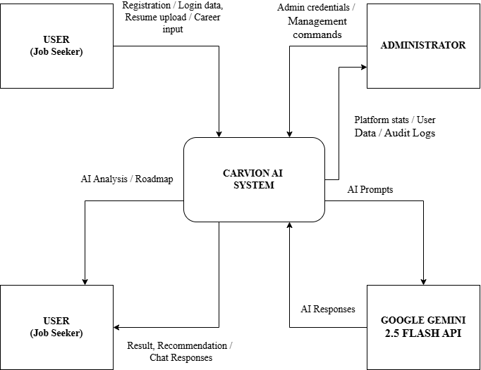
LEVEL 0 – CONTEXT DIAGRAM
Represents the entire Carvion AI platform as a single process.
Shows the interaction between the User, Administrator, and Google Gemini AI.
Illustrates how data enters the system and how results are returned.
Defines the overall system boundary before explaining detailed processes.

Slide 18
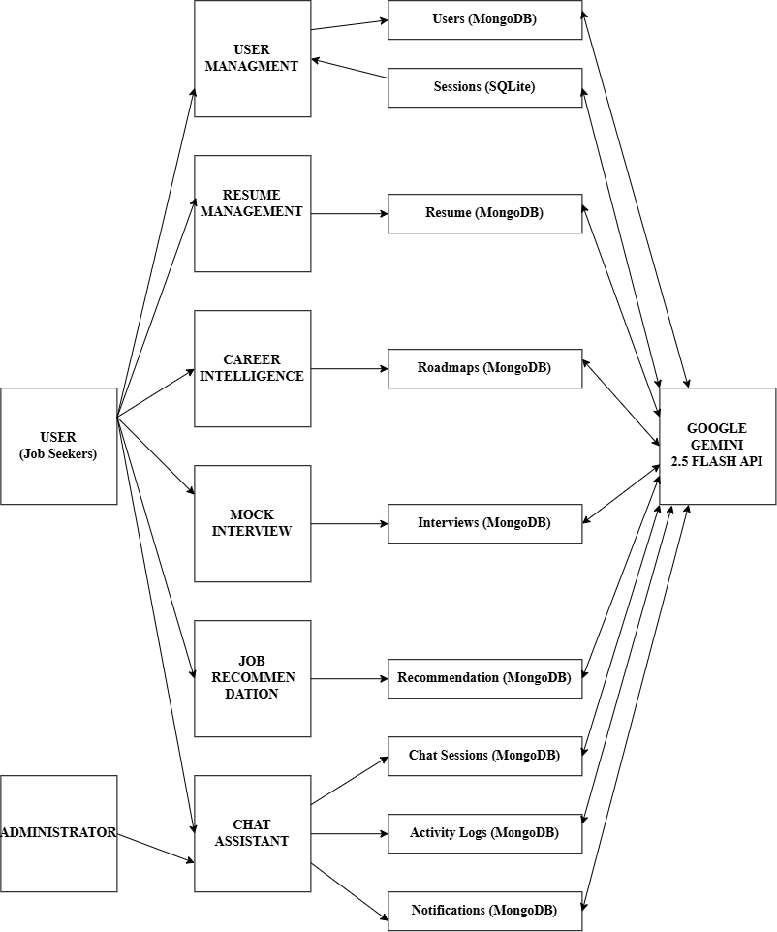
LEVEL 1 DATA FLOW DIAGRAM (DFD)
Expands the Level 0 DFD
Shows the major functional modules
Illustrates data flow between users, the system, databases, and Google Gemini AI
Includes Authentication, Resume Management, Career Roadmap, Mock Interview & AI Chatbot, Job & Course Recommendation, and Admin Dashboard
Uses MongoDB and SQLite for data storage

Slide 19
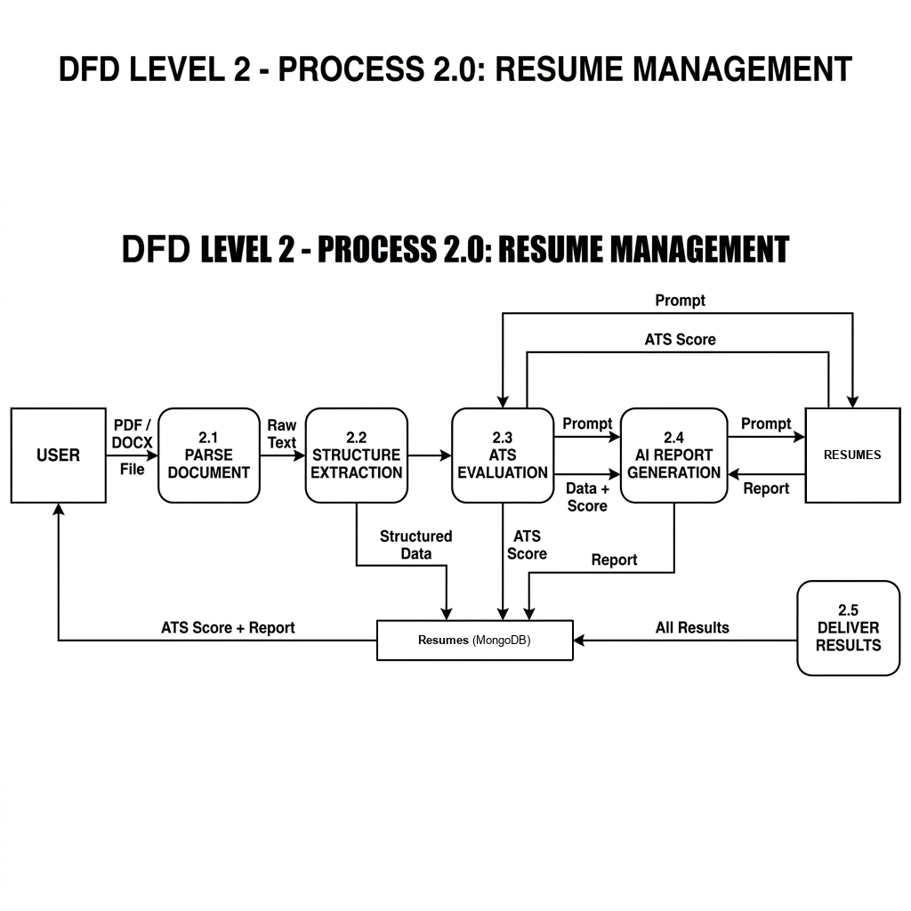
LEVEL 2 DFD (RESUME MANAGEMENT)
Expands the Resume Management process into detailed sub-processes.
Shows how a resume is uploaded, analyzed, stored, and managed.
Illustrates the interaction between the User, Google Gemini AI, and MongoDB.
Explains the complete workflow of AI-based resume analysis.

Slide 20
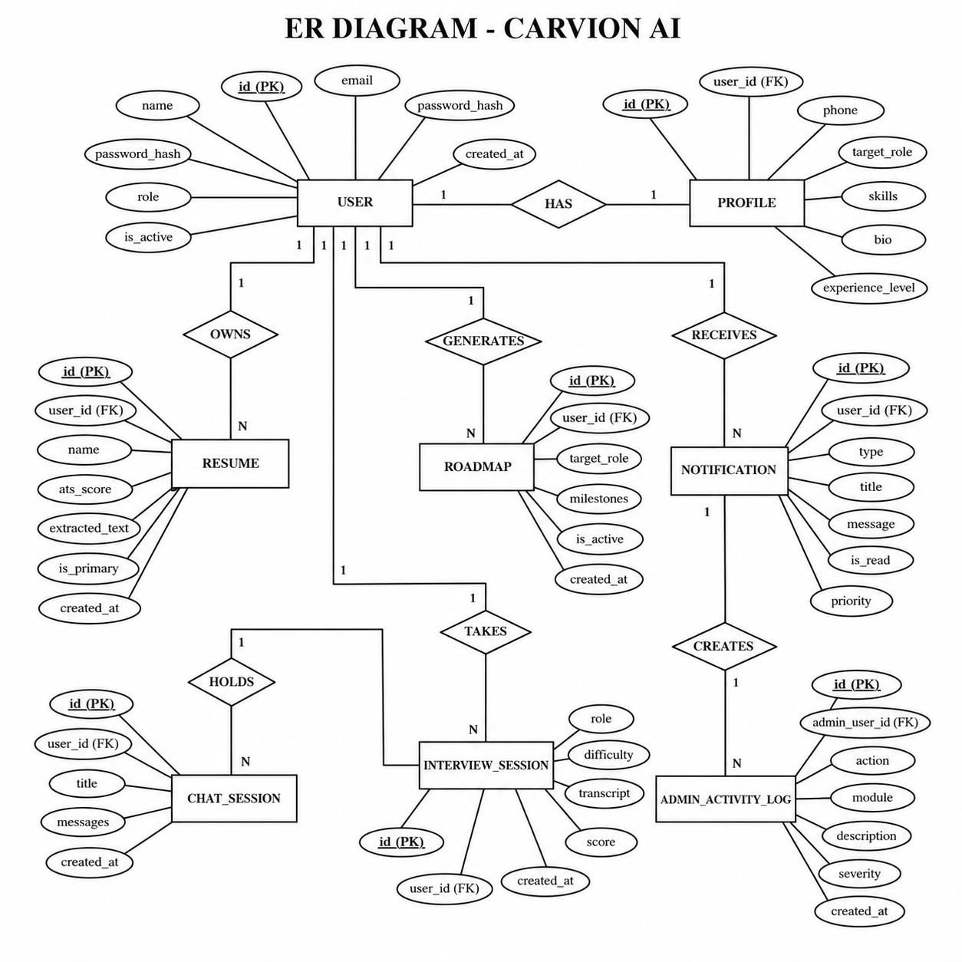
ENTITY RELATIONSHIP DIAGRAM
Represents the database structure of the Carvion AI platform.
Shows the entities, attributes, primary keys, foreign keys, and relationships.
Illustrates how data is stored and connected between different modules.
Helps ensure data consistency, integrity, and efficient data management.

Slide 21
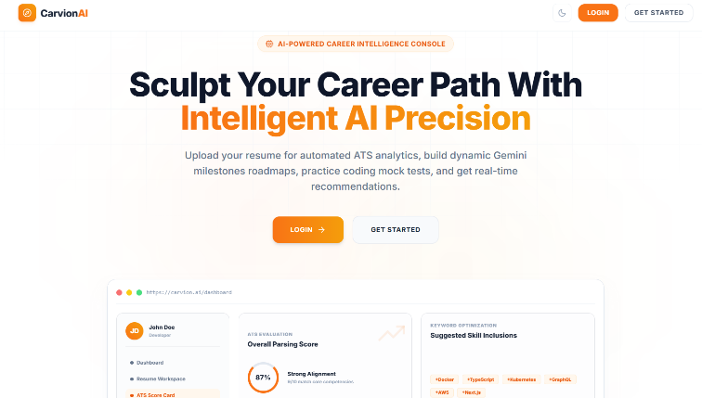
SCREENSHOTS
LANDING PAGE
The landing page introduces the Carvion AI platform and highlights its AI-powered career development features. It provides users with options to register or log in and access personalized career guidance services.

Slide 22
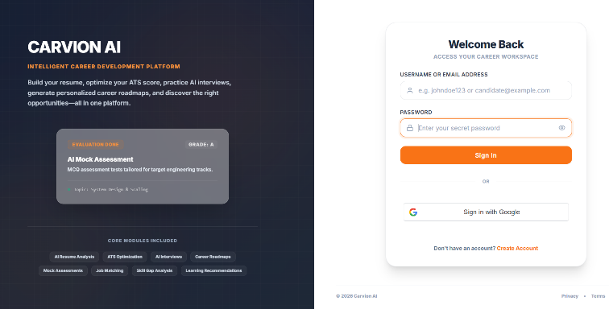
LOGIN PAGE
The login page allows registered users to securely access the Carvion AI platform using their authentication credentials. It ensures authorized access to personalized career analysis, recommendations, and user-specific features.

Slide 23
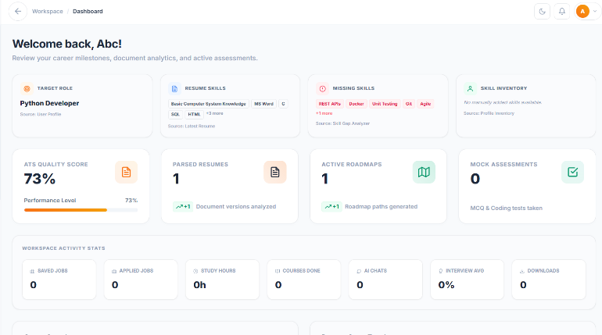
DASHBOARD
The dashboard provides users with a centralized view of their career progress, resume insights, and personalized recommendations. It enables quick access to all major modules and displays important analytics for effective career planning.

Slide 24
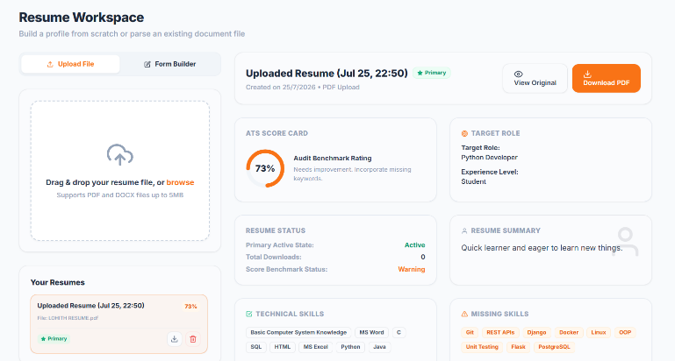
RESUME WORKSPACE
The Resume Workspace enables users to upload, manage, and analyze resumes for AI-based skill extraction and ATS evaluation. It provides a centralized interface for resume optimization and career profile management.

Slide 25
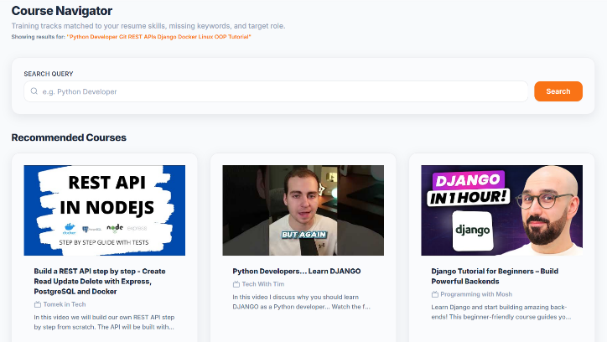
COURSE NAVIGATOR
The Course Navigator recommends personalized learning resources and certification courses based on the user's skill gaps and career goals. It helps users follow a structured learning path to improve their technical and professional competencies.

Slide 26
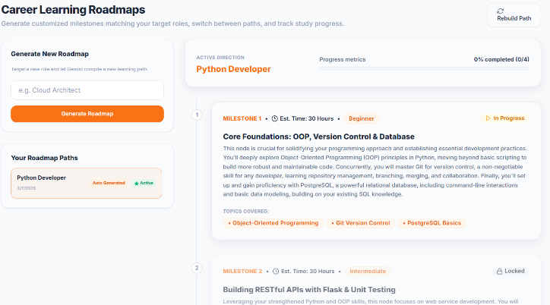
LEARNING ROADMAPS
The Career Roadmaps page generates a personalized step-by-step learning and career progression plan based on the user's skills and target role. It guides users toward achieving their career objectives through structured milestones and recommendations.

Slide 27
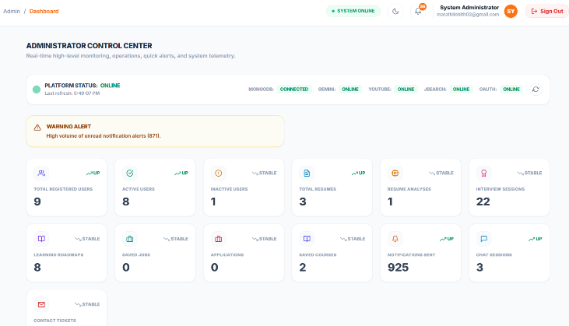
ADMIN DASHBOARD
The Admin Dashboard provides administrators with a centralized interface to monitor users, manage platform activities, and oversee system performance. It enables efficient administration through analytics, user management, and platform monitoring features.

Slide 28
TESTING
TESTING TYPE | PURPOSE | STATUS
Unit Testing | Tested individual modules such as authentication, resume analysis, roadmap generation, chatbot, and interview modules. | Passed
Integration Testing | Verified communication between React frontend, Django backend, MongoDB, and Google Gemini AI. | Passed
System Testing | Tested the complete workflow from user registration to AI-generated results. | Passed
Security Testing | Verified JWT authentication, role-based access control, password security, and API protection. | Passed
Performance Testing | Evaluated API response time, AI processing, and database performance. | Passed
User Acceptance Testing (UAT) | Confirmed that the platform met user requirements and provided a satisfactory user experience. | Passed

Slide 29
RESULTS AND DISCUSSION
RESULTS
The Carvion AI Career Development Platform was successfully developed and tested. All major modules functioned correctly, providing AI-powered resume analysis, career guidance, mock interviews, job recommendations, and learning suggestions. The system demonstrated reliable performance, efficient data management, and accurate AI-generated results.
DISCUSSION
The project successfully achieved its intended objectives by integrating Artificial Intelligence with modern web technologies into a single platform. The application provides reliable career development services while satisfying both the functional and non-functional requirements, making it a secure and user-friendly solution for students and job seekers.

Slide 30
LIMITATIONS OF THE PROPOSED SYSTEM
Dependency on Google Gemini 2.5 Flash API
Limited Resume File Format Support (PDF & DOCX only)
English Language Support Only
No Native Android or iOS Mobile Application
No Offline Support
Limited Job & Learning Resource Sources
Limited Support for Non-IT Career Domains

Slide 31
FUTURE SCOPE
MOBILE APPLICATION – Develop Android and iOS apps for better accessibility.
MULTI-LANGUAGE SUPPORT – Support multiple languages for a wider user base.
ADVANCED AI RECOMMENDATIONS – Improve job and course suggestions using machine learning.
VIDEO-BASED MOCK INTERVIEWS – Analyze communication skills and confidence using AI.
CLOUD DEPLOYMENT – Deploy on AWS, Azure, or GCP for better scalability.
MULTIPLE JOB & LEARNING PLATFORMS – Integrate with additional job portals and online learning platforms.
SUPPORT FOR MULTIPLE CAREER DOMAINS – Expand beyond IT to fields such as Healthcare, Finance, Marketing, and Engineering.

Slide 32
CONCLUSION
Successfully developed the Carvion AI platform to provide AI-powered career development and professional guidance.
Integrated Artificial Intelligence to deliver resume analysis, career roadmaps, mock interviews, and personalized job and learning recommendations.
Achieved all project objectives with successfully functioning modules that work together as a complete career development solution.
Built a secure, scalable, and user-friendly system using modern web technologies and AI services.
Provides a strong foundation for future enhancements, including additional AI features, mobile support, and integration with more career platforms.

Slide 33
THANK YOU
PRESENTED BY: LOHITH MABLESHWARA MARATHI
UUCMS NO: P02JH24S126004

